Slide 1

DATABASE MANAGEMENT SYSTEM
Capstone Project
SOFTWARE MANAGEMENT SYSTEM
Presented by
P.Sahithi [25B11AI958]
CH.Amrutha [25B11AI222]
G.Vijay [25B11AI306]
T.Yamini [25B11AIB61]
GUIDED BY : M. Pravallika Madam
Department of
Artificial Intelligence and Machine Learning

Slide 2

contents
Abstract
Introduction
Problem Statement
Objectives
Entities
Attributes
ER – diagram
Normalization
9. Commands
10. View Queries
11. Join Queries
12. Acid Properties
13. Recovery techniques
14. conclusion
15. Future Scope

Slide 3
Abstract
Software Management System is a DBMS application used to manage software-related Information.
It stores software, user, developer, license, version, and installation details in a centralized database.
The system reduces data redundancy and improves data consistency.
It provides secure data storage and faster information retrieval.
It simplifies software tracking and license management.
It generates reports for better software administration.

Slide 4
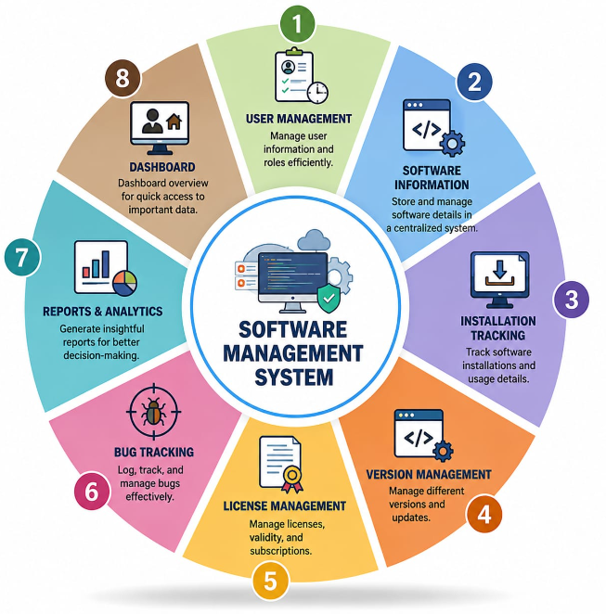
INTRODUCTION:
Stores software-related data in a structured database
Centralized database for software management
Reduces data redundancy
Manages users, licenses, versions and installations
Improves security and data consistency
Provides faster data retrieval
Ensures data accuracy and traceability

Slide 5
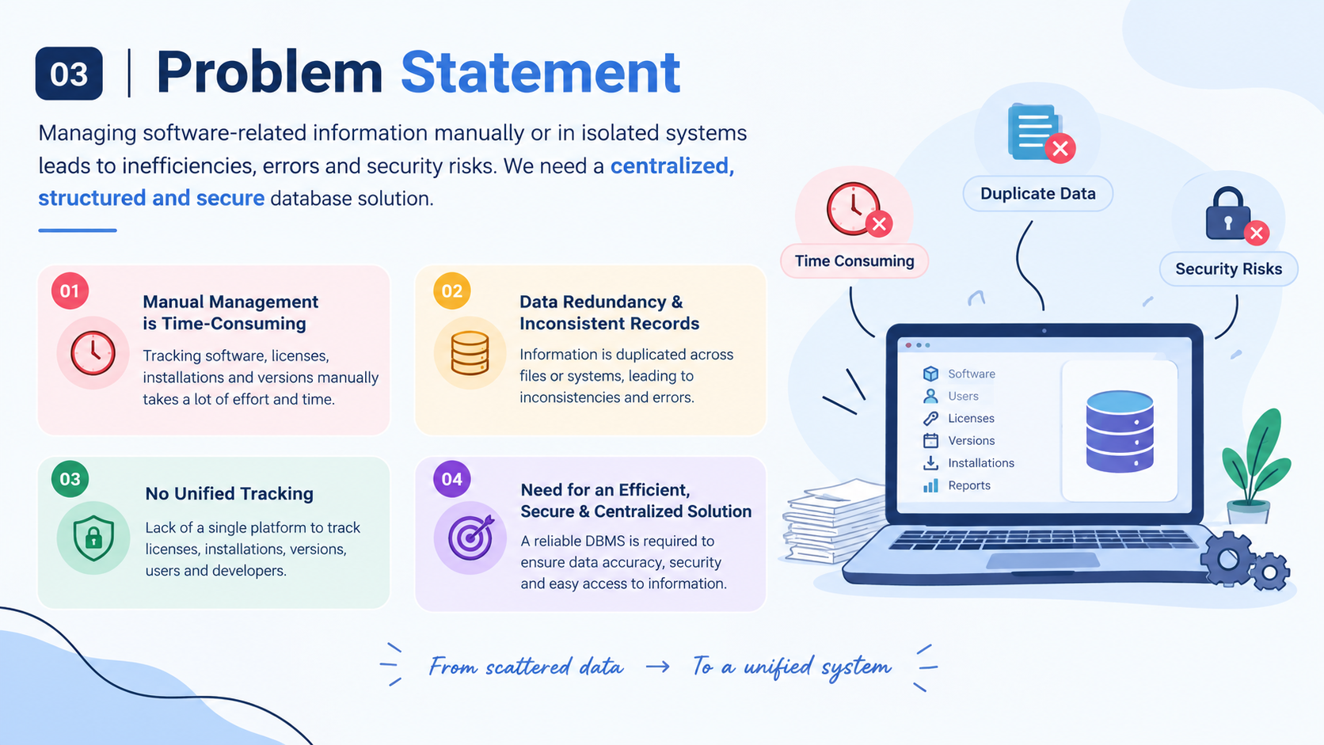

Slide 6
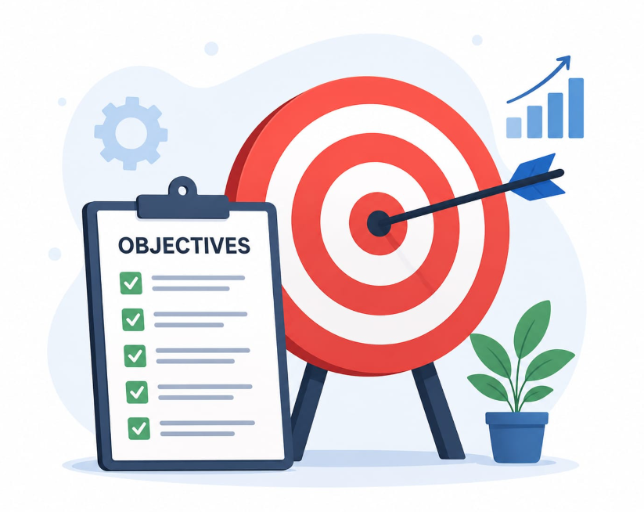
Objectives
Store structured software details
Manage users and their usage
Track versions and updates
Handle licenses and subscriptions
Generate reports for software usage and license status
Maintain data accuracy and auditability

Slide 7





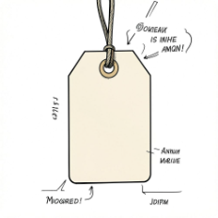

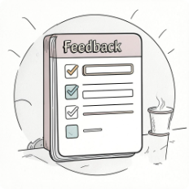

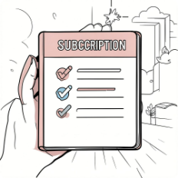
Entities (Tables)
Software
Developer
Users
License
Core application records
Creator/publisher details
End-user information
License type and validity
Installation
Category
Version
Feedback
Install location and date
Software classification
Release and build info
User reviews and ratings
Bug_Report
Subscription
Issues and status
Plans and renewal details

Slide 8
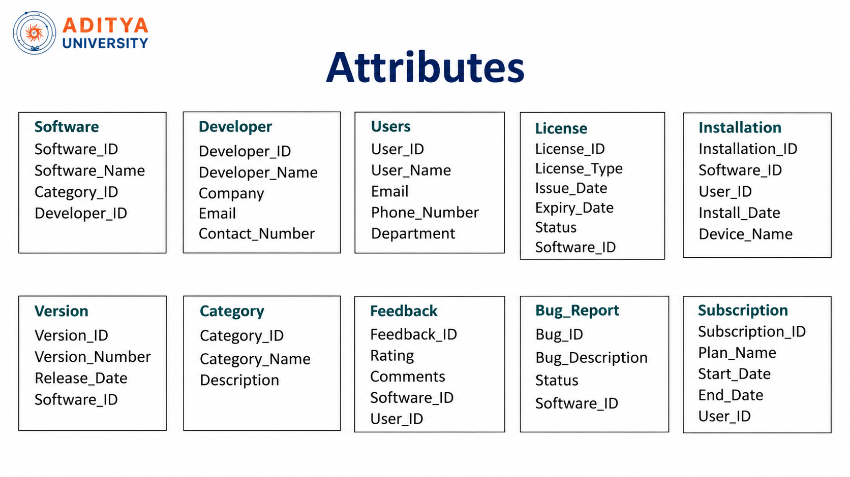
Attributes
Software
Software_ID
Software_Name
Version
Category
Developer_ID
Developer
Developer_ID
Developer_Name
Company
Email
Contact_No
User
User_ID
User_Name
Email
Phone_No.
Department
License
License_ID
License_Type
Issue_Date
Expiry_Date
Status
Installation
Installation_ID
Software_ID
User_ID
Install_Date
Device_Name
Version
Version_ID
Version_Number
Release_Date
Category
Category_ID
Category_Name
Description
Bug_Report
Bug_ID
Bug_Description
Status
Subscription
Subscription_ID
Plan_Name
Start_Date
End_Date
Feedback
Feedback_ID
Rating
Comments

Slide 9
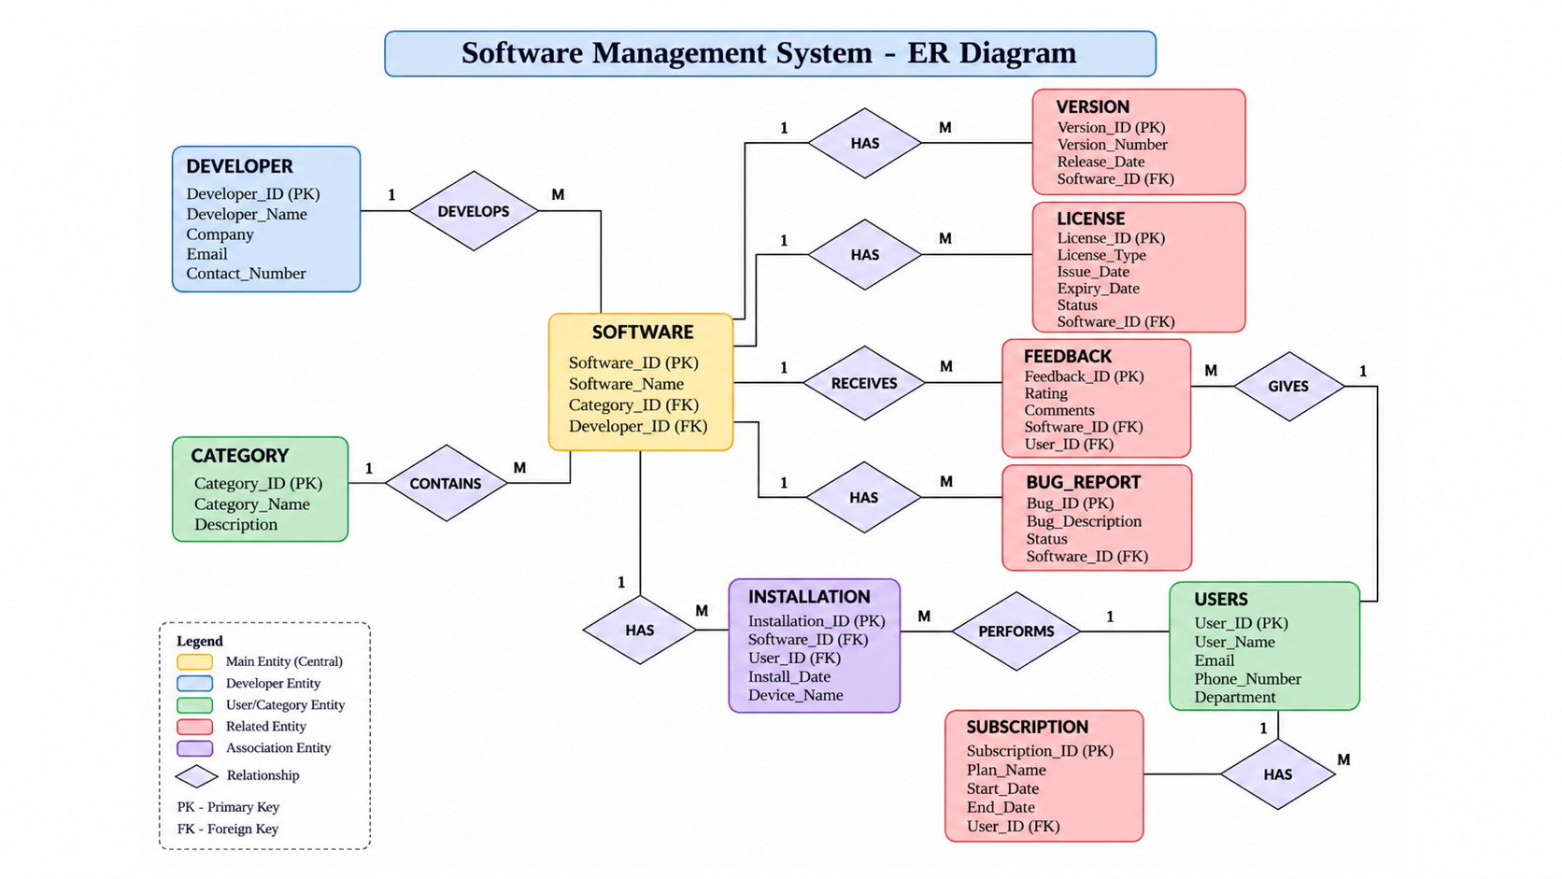
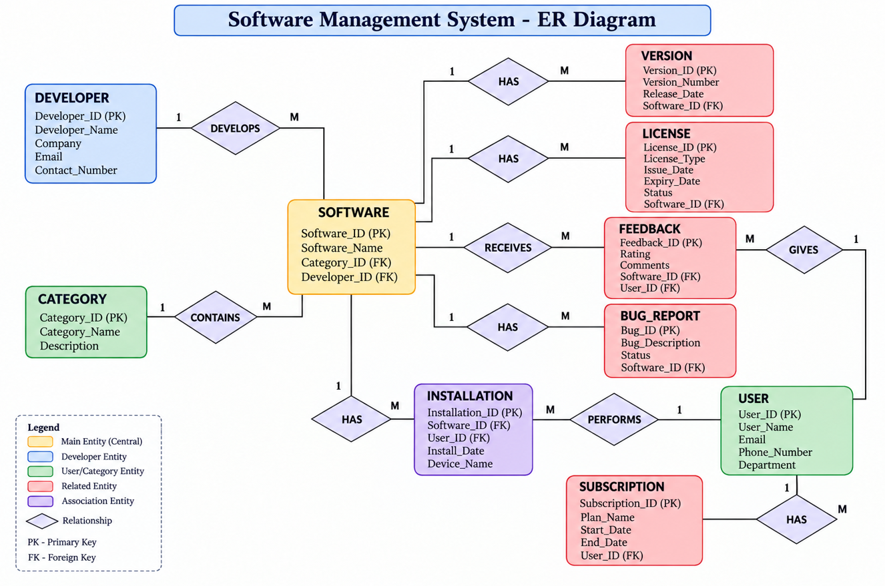

Slide 10
Normalization
Organizing data to reduce redundancy and improve consistency
Why Normalize?
Normal Forms
In Our System
Reduces duplicate data in multiple tables.
Prevents update, insertion, and deletion anomalies.
Makes relationships between entities clearer.
1NF: Each field contains atomic values.
2NF: 1NF + no partial dependency on a composite key.
3NF: 2NF + no transitive dependency.
Software, Developer, Users, License, Version, and other entities are separated.
Keys connect related tables.
This supports accurate and maintainable software records.

Slide 11
Commands
DDL – Data Definition Language
DML – Data Manipulation Language
DCL – Data Control Language
Used to create the database and tables.
Used to insert, update and delete data.
Used to control database users and privileges.
CREATE USER 'project_user'@'localhost'
IDENTIFIED BY 'Project@123';
GRANT SELECT ON SoftwareManagementSystem.Software TO 'project_user'@'localhost’;
GRANT INSERT, UPDATE ON SoftwareManagementSystem.Software TO 'project_user'@'localhost';
REVOKE UPDATE ON SoftwareManagementSystem.Software FROM 'project_user'@'localhost';
REVOKE INSERT ON SoftwareManagementSystem.Software
FROM 'project_user'@'localhost';
CREATE DATABASE SoftwareManagementSystem;
USE SoftwareManagementSystem;
CREATE TABLE Users
(
User_ID INT PRIMARY KEY AUTO_INCREMENT,
User_Name VARCHAR(100) NOT NULL,
Email VARCHAR(100) UNIQUE,
Phone_Number VARCHAR(15),
Department VARCHAR(100)
);
INSERT INTO Software
(Software_Name, Category_ID, Developer_ID)
VALUES ('Microsoft PowerPoint', 3, 1);
UPDATE License
SET Status = 'Expired'
WHERE Expiry_Date < CURRENT_DATE;
DELETE FROM Bug_Report
WHERE Bug_ID = 5
AND Status = 'Resolved';
DDL: CREATE DATABASE, CREATE TABLE
DML: INSERT, UPDATE, DELETE
DCL: CREATE USER, GRANT, REVOKE,
SHOW GRANTS

Slide 12
Join Queries
Combines related records from multiple tables in the Software Management System.
INNER JOIN – Software + Developer
LEFT JOIN – Software + Installation
SELECT S.Software_Name,
D.Developer_Name, D.Company
FROM Software S
INNER JOIN Developer D
ON S.Developer_ID = D.Developer_ID;
SELECT S.Software_Name,
I.Install_Date, I.Device_Name
FROM Software S
LEFT JOIN Installation I
ON S.Software_ID = I.Software_ID;
Purpose: Display software with developer details.
Purpose: Display all software and installation details.
RIGHT JOIN – Users + Installation
SELF JOIN – Same Developer
SELECT S1.Software_Name AS Software1,
S2.Software_Name AS Software2,
D.Developer_Name
FROM Software S1
JOIN Software S2
ON S1.Developer_ID = S2.Developer_ID
AND S1.Software_ID < S2.Software_ID
JOIN Developer D
ON S1.Developer_ID = D.Developer_ID;
SELECT U.User_Name,
I.Install_Date, I.Device_Name
FROM Installation I
RIGHT JOIN Users U
ON I.User_ID = U.User_ID;
Purpose: Display all users and their installation details.
Purpose: Find different software developed by the same developer.

Slide 13
View Queries
Views provide reusable virtual tables for frequently required information and reports.
Updatable View – Active Licenses
Non-updatable View – Software Report
CREATE VIEW Active_Licenses AS
SELECT License_ID, License_Type,
Issue_Date, Expiry_Date,
Status, Software_ID
FROM License
WHERE Status = 'Active';
UPDATE Active_Licenses
SET Status = 'Expired'
WHERE License_ID = 1;
CREATE VIEW Software_Report AS
SELECT S.Software_Name,
D.Developer_Name,
C.Category_Name
FROM Software S
JOIN Developer D
ON S.Developer_ID = D.Developer_ID
JOIN Category C
ON S.Category_ID = C.Category_ID;
Purpose: Manage active license records through the view.
Purpose: Create a combined software, developer and category report.
Display Updatable View
Display Non-updatable View
SELECT *
FROM Active_Licenses;
SELECT *
FROM Software_Report;
Purpose: View the current active-license records.
Purpose: View the combined software report.

Slide 14
ACID Properties
Properties that help maintain reliable database transactions
Atomicity
Consistency
Isolation & Durability
A transaction is completed fully or not at all.
Example: a software installation record should not be partially saved.
A transaction keeps the database in a valid state.
Relationships and constraints remain correct.
Isolation: concurrent transactions do not interfere incorrectly.
Durability: committed changes remain saved even after a failure.

Slide 15
Recovery Techniques
Restoring database operations after failures
Backup & Restore
Log-Based Recovery
Checkpointing
Regular backups provide a safe copy of important data.
Data can be restored after accidental loss or system failure.
Transaction logs record important database changes.
Logs can help redo committed transactions or undo incomplete ones.
A checkpoint records a known consistent state.
It reduces the amount of work required during recovery.

Slide 16
Conclusion
The Software Management System provides a centralized and organized way to manage software-related information.
It efficiently manages software, users, licenses, versions, installations, subscriptions, and bug reports.
Normalization reduces data redundancy and improves data consistency and maintainability.
ACID properties ensure reliable and safe database transactions.
Recovery techniques help protect data and restore database operations after failures.
Overall, the DBMS improves data accuracy, security, retrieval, and software administration.

Slide 17
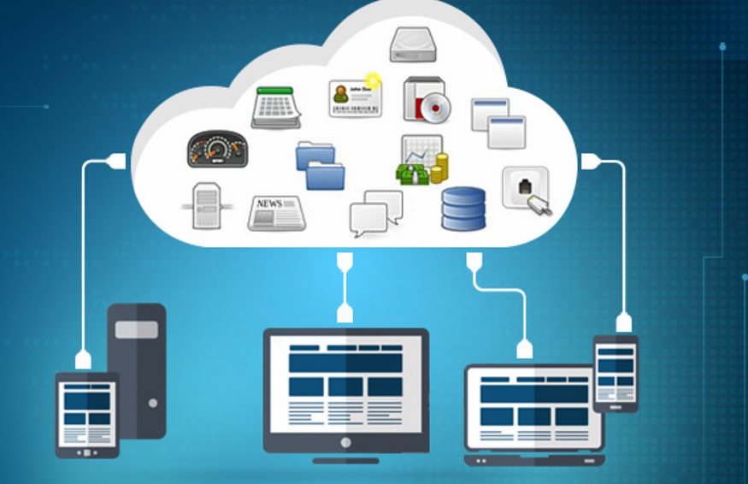
Future Scope
Add role-based access control for administrators, developers, and users.
Introduce automated license-expiry and subscription-renewal notifications.
Provide dashboards and analytics for software usage and license status.
Add cloud deployment for secure access from multiple locations.
Integrate automated backup, recovery, and audit logging.
Extend the system with AI-based insights for usage trends and issue detection.

Slide 18

For your attention.

